Slide 1



Lecture 2a
Softmax Regression
Master in Big Data Solutions 2020-2021 - Artificial Intelligence
Xavier Giró
xavier.giro@bts.tech

Slide 2




Acknowledgements
Santiago Pascual
Kevin McGuinness
kevin.mcguinness@dcu.ie
Research Fellow
Insight Centre for Data Analytics
Dublin City University

Slide 3
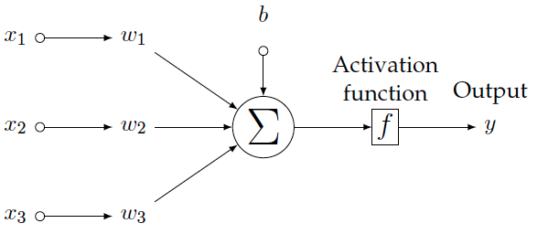
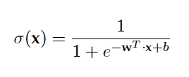
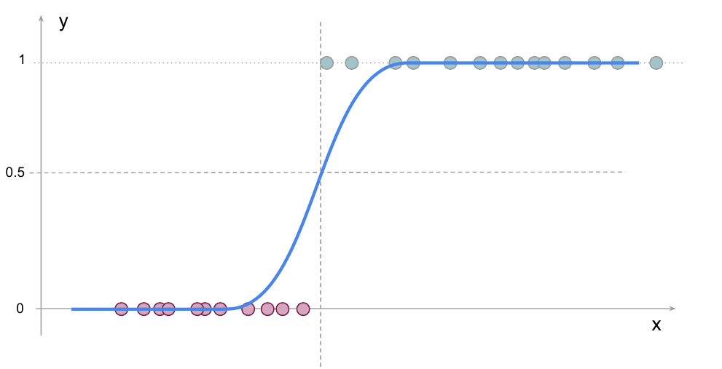
Previously… Logistic Regression
y > ૪ → class 1
(eg. green)
y < ૪ → class 2
(eg. red)
Logits
Threshold (૪)

Slide 4






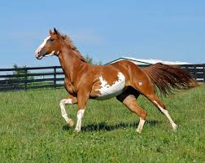
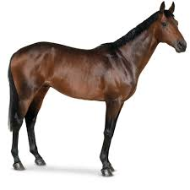
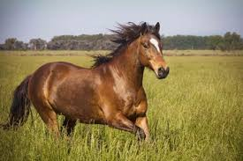


Softmax regression: Multiclass (N classes)
Question: How could the binary classifier with logistic regression to a problem with more than 2 classes (N) ?

Slide 5
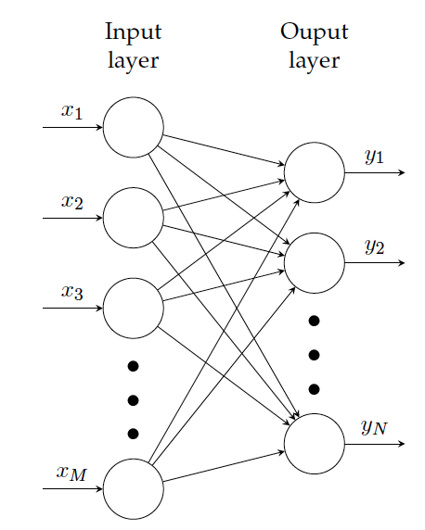

Softmax regression: Multiclass (N classes)
Question: How could the binary classifier with logistic regression to a problem with more than 2 classes (N) ?
raw pixels unrolled img
A multiclass classification problem can be solved by assigning a perceptron for each class and choosing the maximum (arg max) logit…
0.3 “dog”
0.08 “cat”
0.6 “whatever”

Slide 6
Softmax regression: Multiclass (N classes)
Question: How could the binary classifier with logistic regression to a problem with more than 2 classes (N) ?
raw pixels unrolled img
A multiclass classification problem can be solved by assigning a perceptron for each class and choosing the maximum (arg max) logit…
but this function is non-differentiable (can’t backprop).
0.3 “dog”
0.08 “cat”
0.6 “whatever”

Slide 7
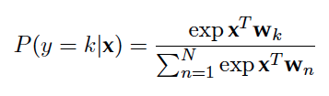
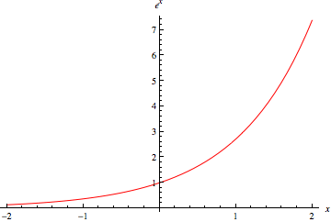
Softmax regression: Multiclass (N classes)
The output logits are normalized with the softmax function, which is differentiable:
Softmax regression
raw pixels unrolled img
0.3 “dog”
0.08 “cat”
Exponential exp(·) boosts higher logits (max effect).
0.6 “whatever”
‹#›

Slide 8
Softmax regression: Multiclass (N classes)
The output logits are normalized with the softmax function, which is differentiable:
Softmax regression
raw pixels unrolled img
0.3 “dog”
0.08 “cat”
Normalization factor so that the sum of confidences sum up to 1.
0.6 “whatever”
‹#›

Slide 9
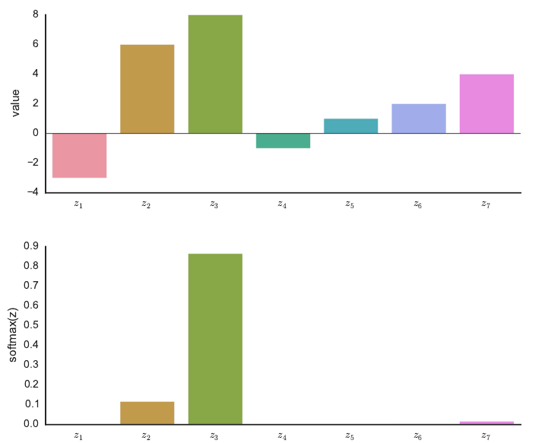
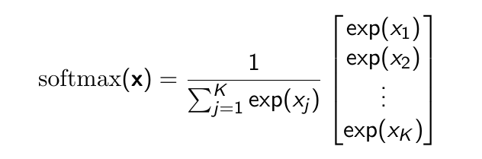
Softmax regression
softmax

Slide 10
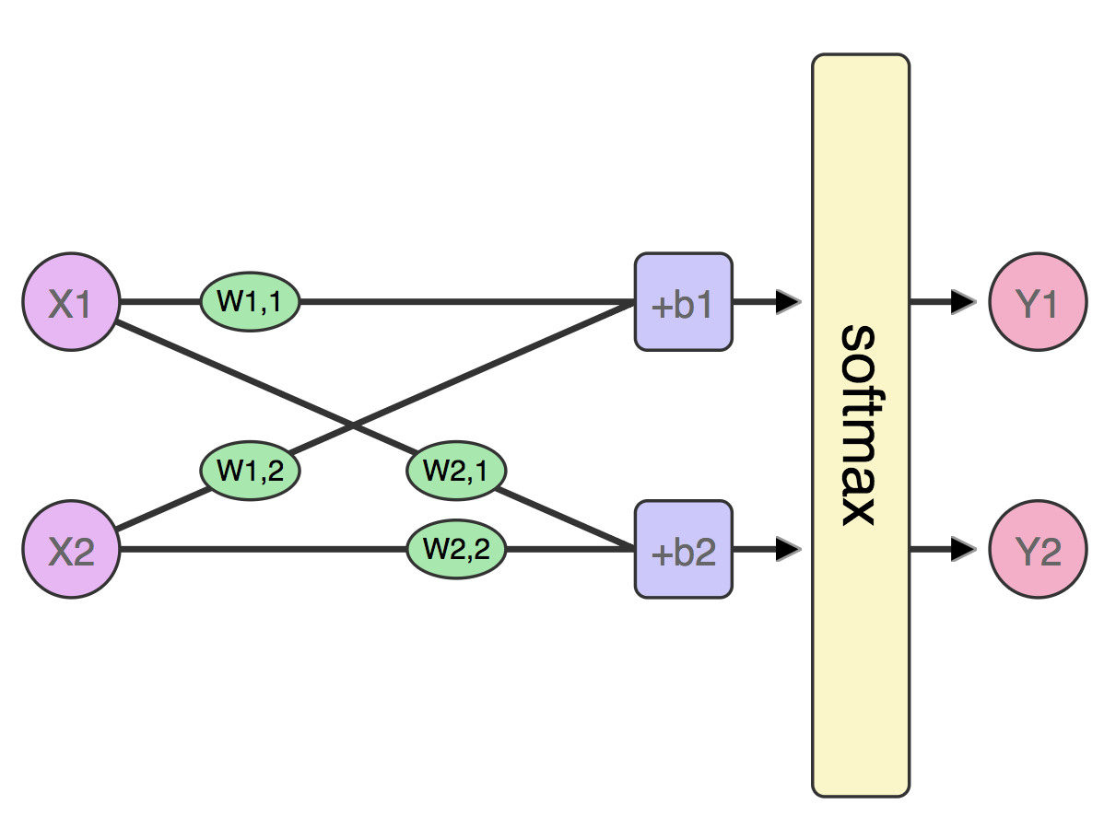
Softmax regression: Binary case
Example: Binary classification can also be solved with two perceptrons + softmax.
J. Alammar, “A visual and interactive guide to the Basics of Neural Networks” (2016)

Slide 11
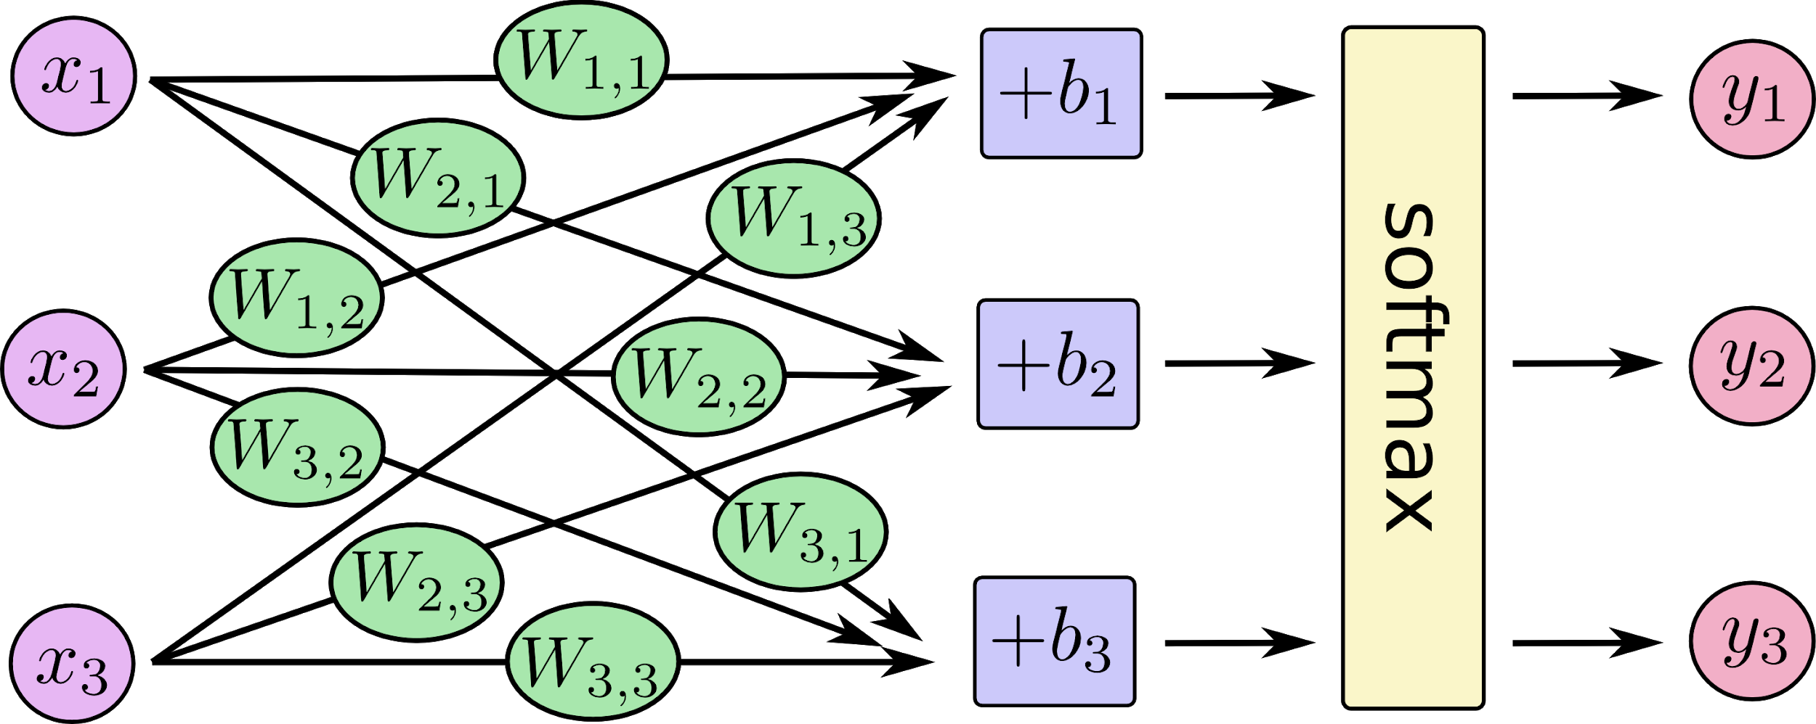
Softmax regression: Multiclass (3 classes)
TensorFlow, “MNIST for ML beginners”

Slide 12
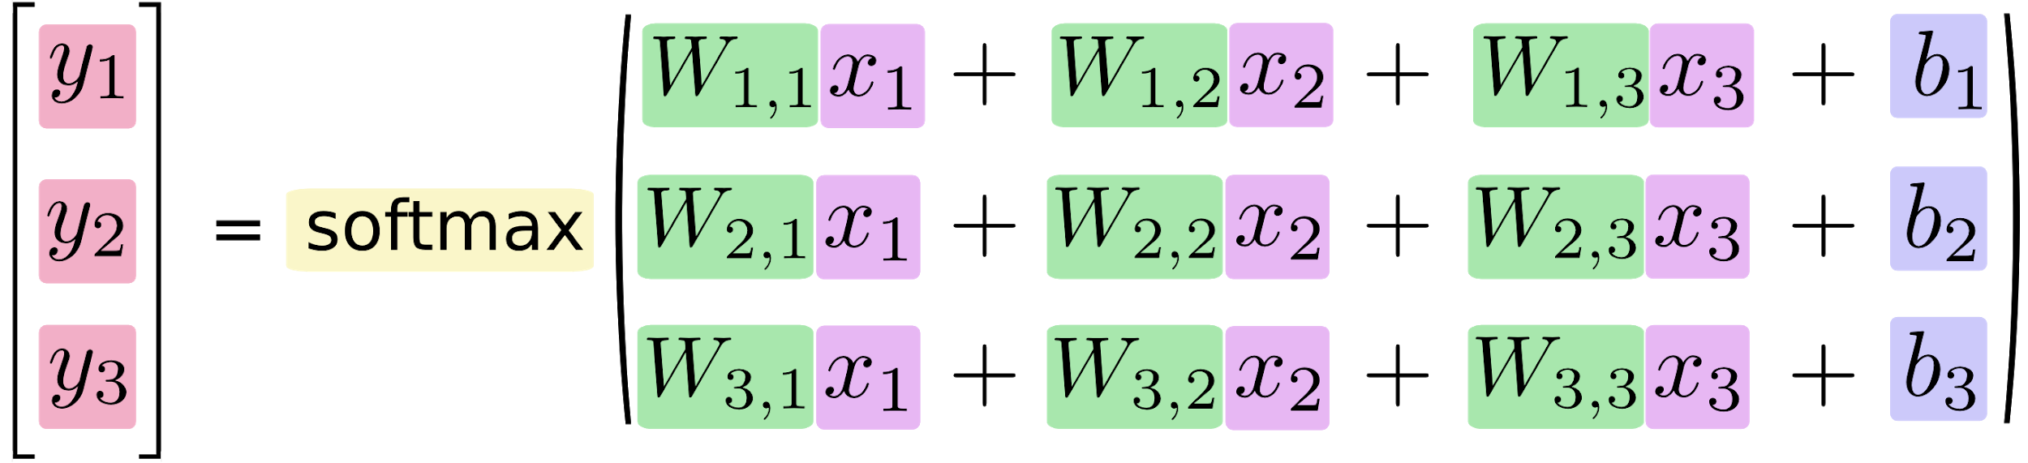
Softmax regression: Multiclass (3 classes)
TensorFlow, “MNIST for ML beginners”

Slide 13
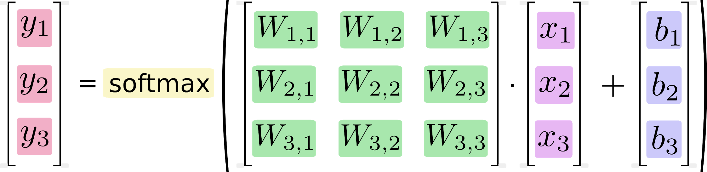

Softmax regression: Multiclass (3 classes)
TensorFlow, “MNIST for ML beginners”

Slide 14


Software implementation
LogSoftMax
y1
y2
y3
.
.
.
.
.
.
yN

Slide 15
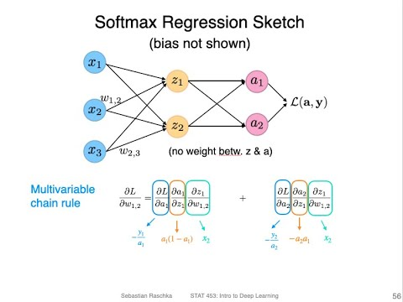
Learn more
Sebastian Raschka, “STAT 453: Intro to Deep Learning”. University of Wisconsin-Madison 2021. [tweet]

Slide 16
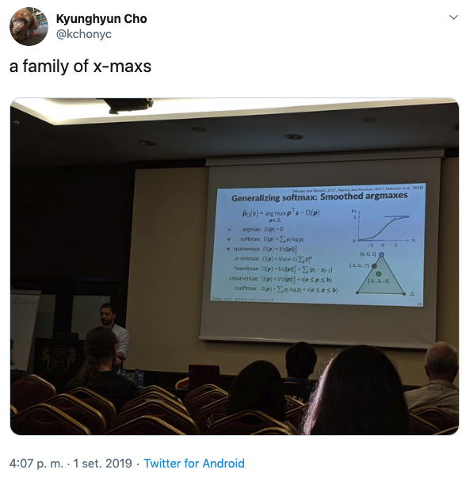
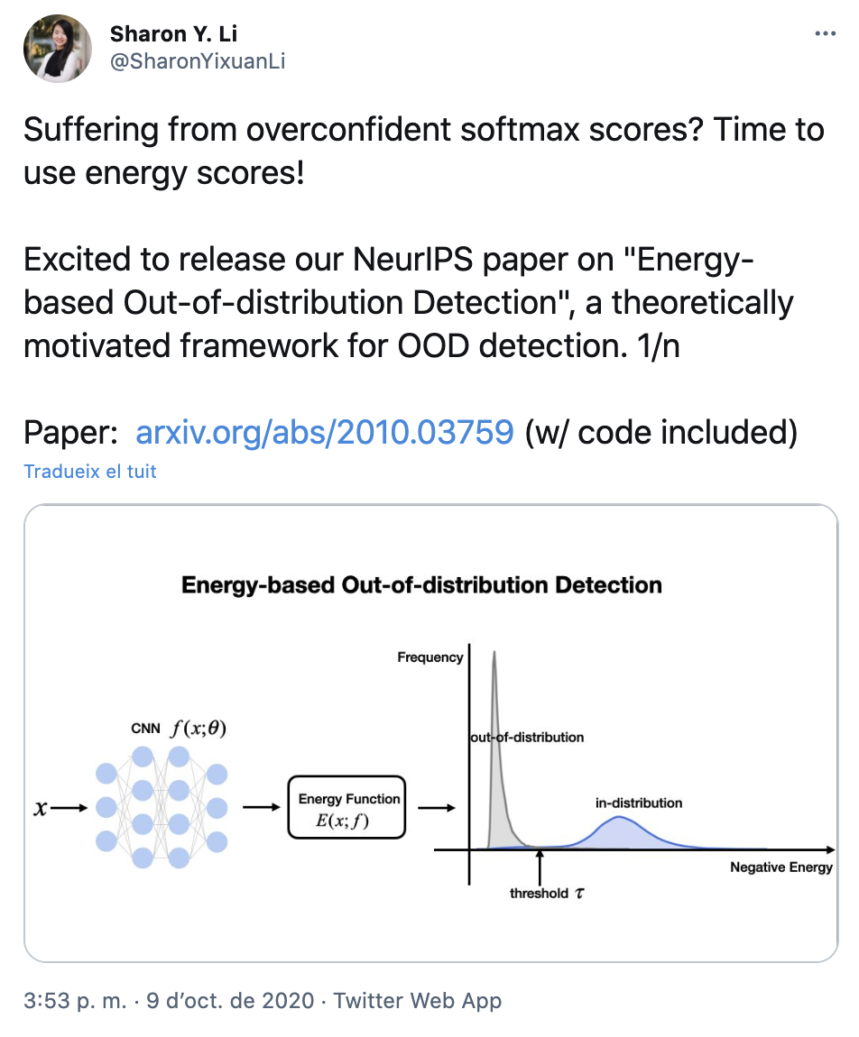
Learn more
From “End-to-end differentiable relaxations”:
https://deep-spin.github.io/tutorial/acl.pdf

Slide 17


